Slide 1
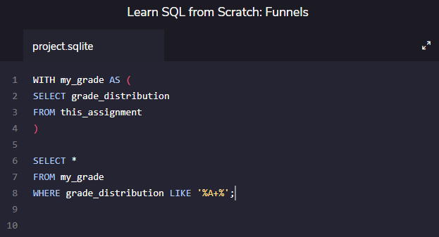
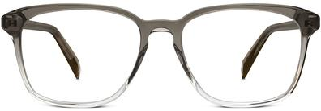
Codecademy: Learn SQL from Scratch
Christopher Arnold | July 2, 2018
Capstone: Funnels with Warby Parker
Pictured: The Bestselling Dawes Driftwood Fade

Slide 2
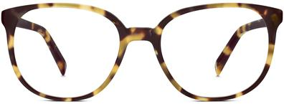
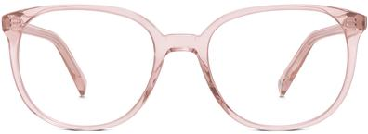
Table of Contents
1. Warby Parker: A Company of Vision
2. Survey: Style Quiz Funnel
What is a marketing funnel?
Style Quiz questions
Survey table columns
Quiz responses and “give-up” percentages
Questions with lowest response rates
Rationale for funnel failure Q#3
Rationale for funnel failure Q#5
Pictured: The Second Bestselling Eugene Narrow Rosewood Tortoise
3. A/B Testing: Home Try-On Funnel
Quiz → Home Try-On → Purchase Funnel
Schema of related tables
Analyzing success of funnel
A/B test: Number of Pairs
4. Other Insights
Results of Style Quiz
Purchase Data
Color Commitment
Pictured: The Third Bestselling Eugene Narrow Rose Crystal

Slide 3
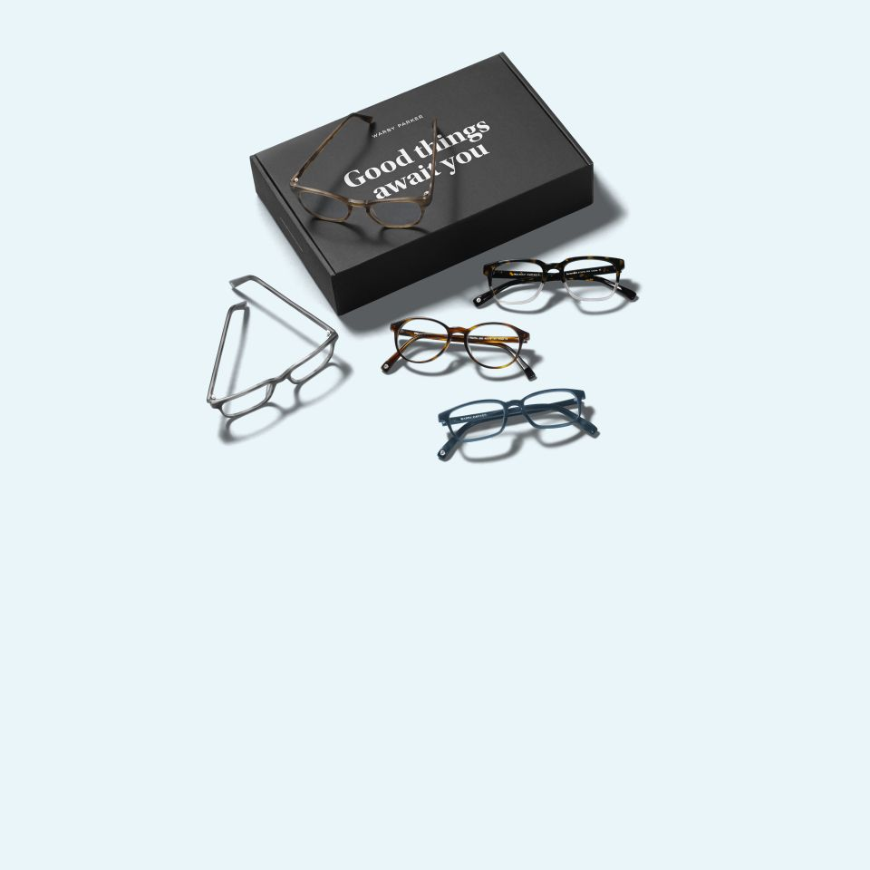
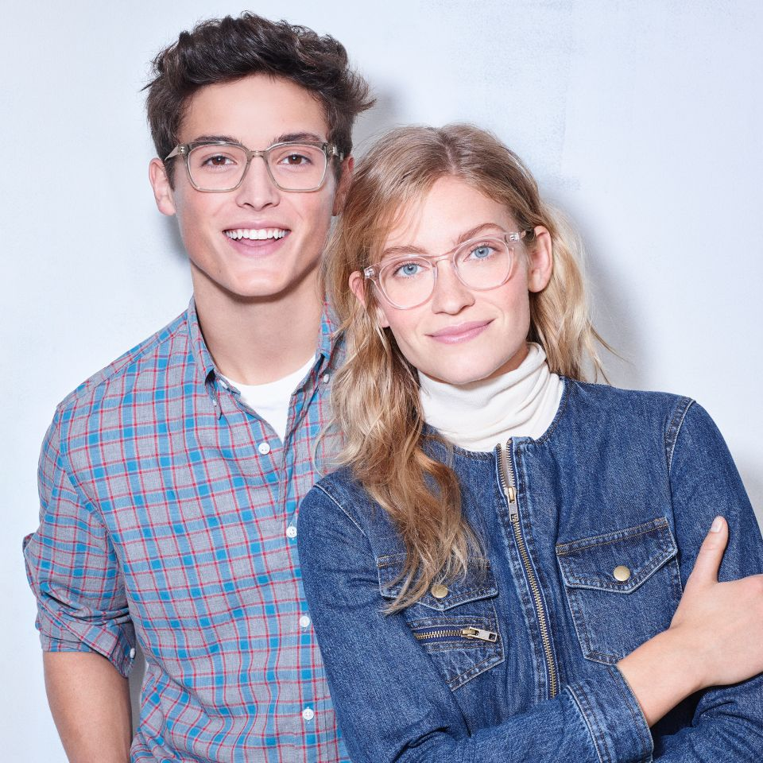
1. Warby Parker: A Company of Vision
Co-founded in Philadelphia in 2010 by Neil Blumenthal and Dave Gilboa, Warby Parker is an American online retailer of prescription glasses and sunglasses. They are a lifestyle brand with a lofty objective: to offer designer eyewear at a revolutionary price while leading the way for socially conscious businesses.
By engaging directly with consumers, they are able to offer ultra-high-quality, vintage-inspired frames for $95 including prescription lenses and shipping. They focus on the bigger picture, too: social innovation is woven into the DNA of the company, and for every pair of glasses purchased, a pair is distributed to someone in need.
Warby Parker partners with the non-profit organization called VisionSpring, and they have distributed over 1 million pairs of eyeglasses to people in need.
As you can see, Warby Parker is much more than simply the inverse of Zagg Pepper.

Slide 4
2. Survey: Style Quiz Funnel
A marketing funnel is a model which helps track the stages consumers travel through when being led towards the purchase of a product or service. This system allows businesses to analyze at which point customers are giving up in their journey towards being converted into buyers.
To help users find their perfect frame, Warby Parker has a Style Quiz that has the following questions:
"What are you looking for?"
"What's your fit?"
"Which shapes do you like?"
"Which colors do you like?"
"When was your last eye exam?
The responses to these questions are stored in a table called survey which has the following data schema:
survey
question | TEXT
user_id | TEXT
response | TEXT
Table 2.1: Schema of survey table

Slide 5
2. Survey: Style Quiz Funnel (cont’d)
A certain percentage of users will normally navigate away from a website at different points during a survey. Table 2.2 shows the number of responses and percentage of users who “give-up” at each question in the survey funnel.
The questions that received the lowest response rates compared to the previous question were #3 and #5.
I suspect that question #3 loses 20% of the audience because, with only three choices (round, square, or rectangle), there are not enough shape options. I believe that this question demonstrates that people are looking for different types of glasses than what Warby Parker offers.
I believe that question #5 loses ~ 25% of the survey takers from question #4 because asking them when their last eye exam was may remind potential buyers that they’d rather receive an optometrist’s opinion before making a purchasing decision. Either that, or they cannot remember the last time they had an eye exam, so they get distracted and don’t answer the question. As shown in Table 2.3, most of the affirmative responses were for <1 Year, and the least affirmative responses were for 3+ Years or Not Sure, which suggests a possible correlation between the longer a survey taker has gone without an eye exam, and a less likelihood of responding.
question | #_of_responses | %_of_previous
1. What are you looking for? | 500 | 100%
2. What's your fit? | 475 | 95%
3. Which shapes do you like? | 380 | 80%
4. Which colors do you like? | 361 | 95%
5. When was your last eye exam? | 270 | 75%
Table 2.2: Quiz Responses and “Give-Up” Percentage
question | response | #_of_responses
5. When was your last eye exam? | <1 Year | 141
5. When was your last eye exam? | 1-3 Years | 56
5. When was your last eye exam? | 3+ Years | 37
5. When was your last eye exam? | Not Sure. Let’s Skip It | 36
Table 2.3: Question #5 Responses

Slide 6
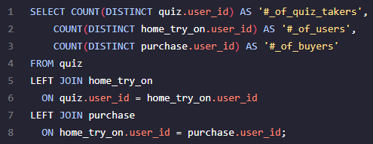
3. A/B Testing: Home Try-On Funnel
quiz
user_id | TEXT
style | TEXT
fit | TEXT
shape | TEXT
color | TEXT
Now that we have evaluated the simple survey-style funnel, we can evaluate the larger marketing funnel that Warby Parker employs. This funnel uses the following 3 steps:
Quiz
Home Try-On
Purchase
We can analyze the efficacy of this funnel by querying the quiz, home_try_on, and purchase tables, which have data schemas shown in Table 3.1.
In order to determine the success of the funnel, the following query was used to find how many people were lost at each step of the funnel:
home_try_on
user_id | TEXT
number_of_pairs | TEXT
address | TEXT
purchase
user_id | TEXT
product_id | INTEGER
style | TEXT
model_name | TEXT
color | TEXT
price | INTEGER
Table 3.1: Schema of quiz, home_try_on, and purchase tables
Query 3.1: Determing number of unique users remaining in each step of funnel

Slide 7
3. A/B Testing: Home Try-On Funnel (cont’d)
Table 3.2 shows the results of the query. Doing the math, we can see that 75% of quiz-takers went on to participate in the home try-on program, and 66% of home try-on participants proceeded to purchase a pair of glasses.
#_of_quiz_takers | #_of_users | #_of_buyers
1000 | 750 | 495
Table 3.2: Quiz → Home Try-On → Purchase funnel
During the Home Try-On stage, Warby Parker conducted an A/B test by adjusting the number of pairs of glasses sent for home try-on. An A/B test is a method where two marketing strategies are utilized in parallel and then analyzed retrospectively to determine which strategy is superior.
50% of the users received 3 pairs to try on (actual: 50.5%)
50% of the users received 5 pairs to try on (actual: 49.5%)
Table 3.3 shows the results for the Number of Pairs A/B Test. 79.2% of customers who were sent 5 pairs made a purchase vs. 53% of customers who were sent 3 pairs. That is a significant difference!
number_of_pairs | lost_quiz_takers | number_of_users | number_of_buyers | %_success
5 pairs | 0 | 371 | 294 | 79.2%
3 pairs | 0 | 379 | 201 | 53.0%
 | 250 | 0 | 0
Table 3.3: Number of Pairs A/B Test

Slide 8
4. Other Insights
style | #_of_responses
Women's Styles | 469
Men's Styles | 432
I'm not sure. Let's skip it. | 99
Table 4.1 shows the results of the Style Quiz. These responses show which colors and styles are the most popular. Warby Parker has a lot of customization options, but should consider expanding them to fill any voids in the following cross-sections:
Women’s Style
Narrow Fit
Rectangular and Square Shaped
Tortoise and Black Colored
This A/B test resulted in $55,795 worth of revenue. The purchase results and product hierarchy can be seen on the next page in Table 4.2. Here are a few financial data points on the program’s success:
The most popular glasses are the Dawes Driftwood Fade (by far)
Revenue per quiz-taker: $55.80
Revenue per home try-on: $74.39
Revenue per purchaser: $112.72
Revenue per pair of glasses sent for home try-on: $18.65
Revenue per pair of glasses sent for home try-on (3 pairs): $20.02
Revenue per pair of glasses sent for home try-on (5 pairs): $17.81
Therefore, if there is a difference in the risk of cost/damage/loss mitigation of $2.22/pair of glasses sent for home try on, it may still be better to send 3 even though less sales are made.
fit | #_of_responses
Narrow | 408
Medium | 305
Wide | 198
I'm not sure. Let's skip it. | 89
shape | #_of_responses
Rectangular | 397
Square | 326
Round | 180
No Preference | 97
color | #_of_responses
Tortoise | 292
Black | 280
Crystal | 210
Neutral | 114
Two-Tone | 104
Table 4.1: Style Quiz Responses

Slide 9
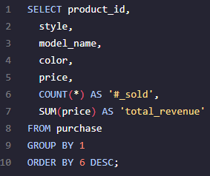
4. Other Insights (cont’d)
product_id | style | model_name | color | price | #_sold | total_revenue
3 | Men's Styles | Dawes | Driftwood Fade | 150 | 63 | 9450
10 | Women's Styles | Eugene Narrow | Rosewood Tortoise | 95 | 62 | 5890
9 | Women's Styles | Eugene Narrow | Rose Crystal | 95 | 54 | 5130
1 | Men's Styles | Brady | Layered Tortoise Matte | 95 | 52 | 4940
6 | Women's Styles | Olive | Pearled Tortoise | 95 | 50 | 4750
4 | Men's Styles | Dawes | Jet Black | 150 | 44 | 6600
7 | Women's Styles | Lucy | Elderflower Crystal | 150 | 44 | 6600
2 | Men's Styles | Brady | Sea Glass Gray | 95 | 43 | 4085
8 | Women's Styles | Lucy | Jet Black | 150 | 42 | 6300
5 | Men's Styles | Monocle | Endangered Tortoise | 50 | 41 | 2050
Query 4.1: Finding most successful items by product_id
Table 4.2: Purchase Results

Slide 10
4. Other Insights (cont’d)
purchase_color | COUNT(*)
Tortoise | 205
Other | 106
Crystal | 98
Black | 86
Color Commitment: What if we were to ask to question - How likely is someone to buy the color of glasses that they answered in the quiz? In other words, which colors demand the most loyal of followings? We will do this exercise for the three most popular colors: tortoise, crystal, and black.
Table 4.3: Purchases by Color
color | COUNT(*)
Black | 150
Tortoise | 144
Crystal | 104
Two-Tone | 49
Neutral | 48
Table 4.3 shows the number of purchases of each color. Table 4.4 shows how the eventual buyers initially answered their color preferences on the Quiz. Table 4.5 shows the number of people who followed through with the color they had originally identified interest in. Finally, Table 4.6 shows the percentage of which color demands the most customer loyalty.
Table 4.4: Initial Quiz Color Preference of Purchasers
quiz_color | purchase_color | #_of_color_committers
Tortoise | Tortoise | 47
Black | Black | 24
Crystal | Crystal | 24
Color | Likelihood of Committing to Color
Tortoise | 33%
Black | 16%
Crystal | 23%
Table 4.5: Number of People who Commit to Each Color
Table 4.6: Likelihood of Committing to Color

